Slide 1
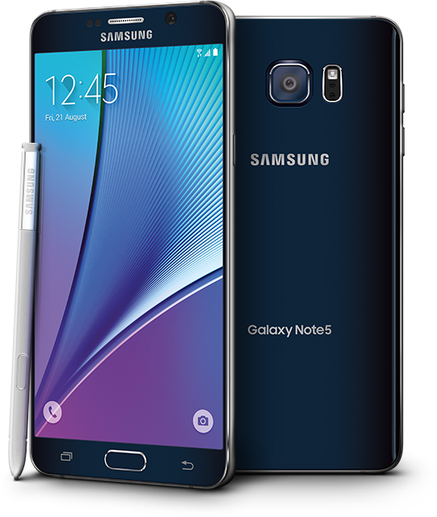
Join a lifesize video conference with an Android system
www.mathec.com

Slide 2
Step 1: Download the FREE lifesize application on the google play
www.mathec.com

Slide 3
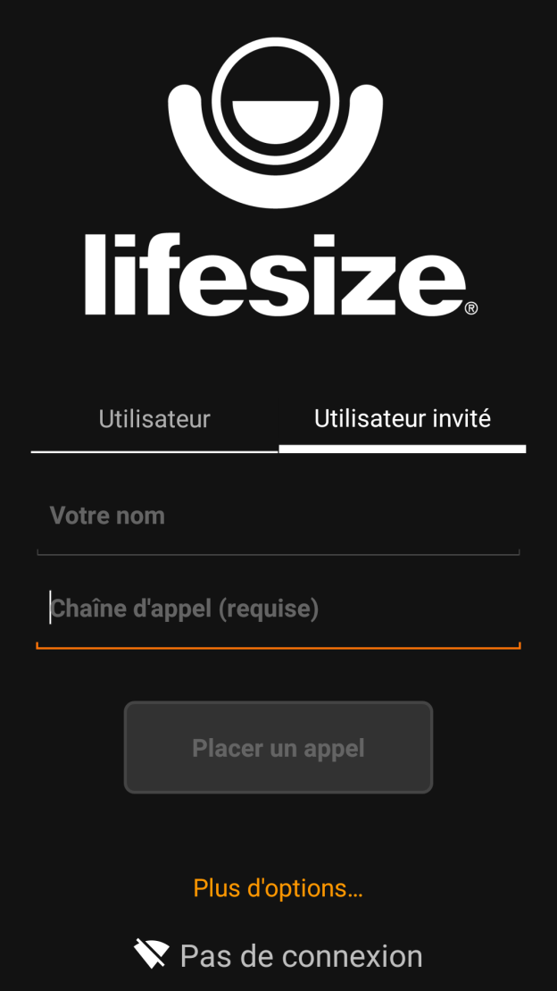
Step 2 : Open the application and enter the conference number indicate in the mail of invitation (Watch out : do not enter the passeword on this step)
Click here and select the guest option
Indicate your name
Indicate the conference number received by email (more details on the next slide)
Click here to call
www.mathec.com

Slide 4
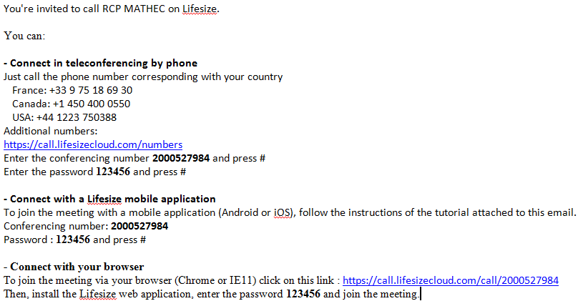
Step 2 : Where can you find the conference number in the email ?
The conference number is here
www.mathec.com

Slide 5
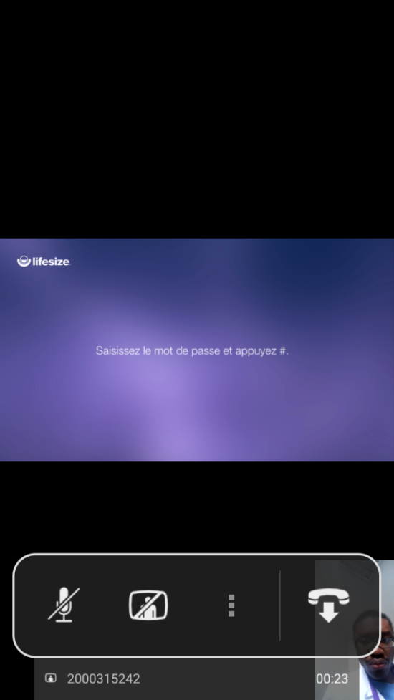
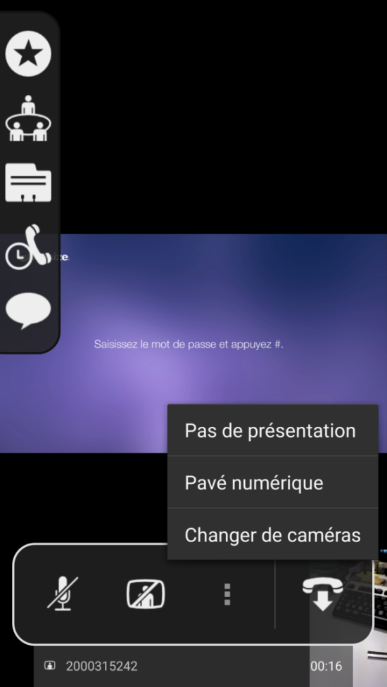
Step 3 : Join the visio conference
Click here to display the number pad and enter the password received by mail (more details in next slide) and, then, press #
Tap this icon
www.mathec.com

Slide 6
Step 3: Where can you find the conference password in the mail ?
The password is here
www.mathec.com

Slide 7
You are now connected to the lifesize tele/video conference
www.mathec.com

